Slide 1
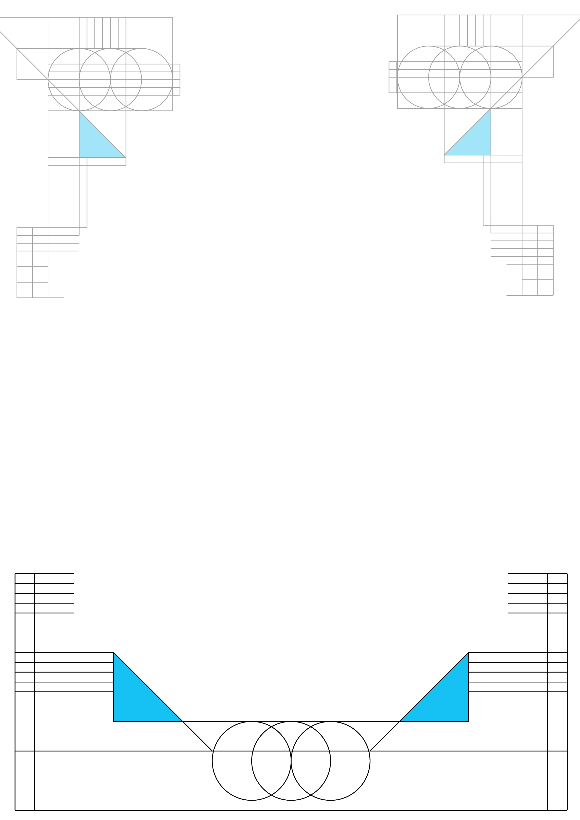
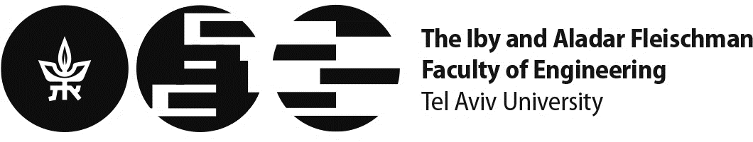
UTILIZING HOME EXPERIMENT KITS FOR HYBRID LEARNING METHODOLOGY
Arkadi Rafalovich
Tel Aviv University arkadira@tauex.tau.ac.il
Roi Raich
Tel Aviv University roiraich@tauex.tau.ac.il

Slide 2
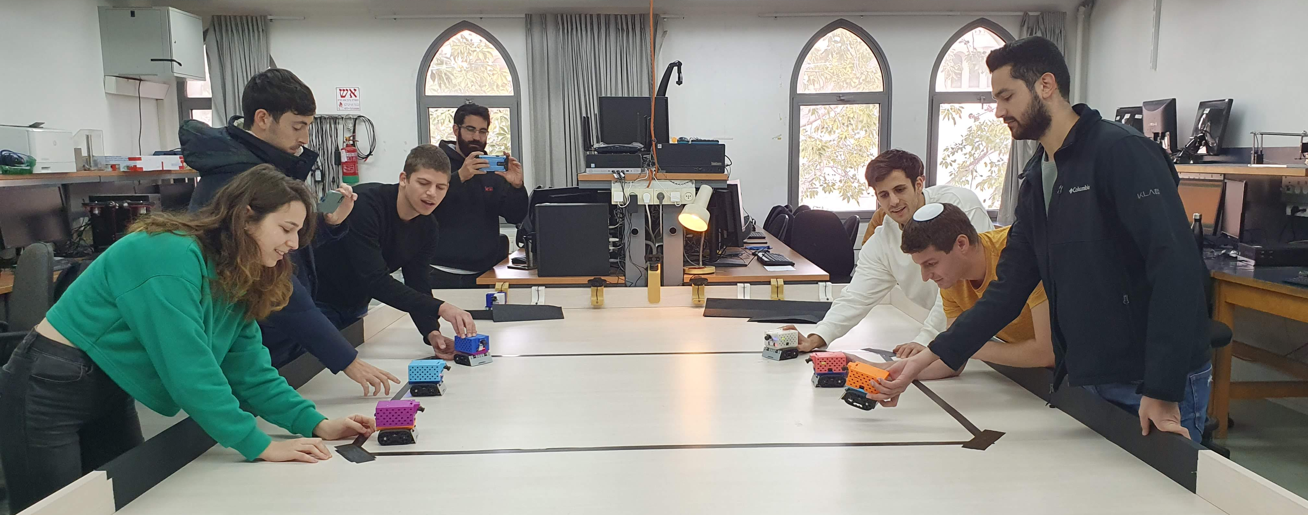
,
Welcome to the lab

Slide 3
,
Overview
Workshop objectives and what participants will learn about:
Introduction to hybrid learning methods
Introduction to our hybrid learning systems
Demonstrations of our hybrid learning systems
Hands on experience with our hybrid learning systems
Small groups discussions on the benefits of hybrid learning
Conclusions and summary of the workshop

Slide 4
,
Overview
Hybrid learning methods:
Synchronous learning with or without live online access
Asynchronous learning (watching prerecorded lectures)
Flipped classroom using take home experiment kits
Benefits:
Flexibility
Enhanced engagement
Accessibility
Convenience
Self-paced learning

Slide 5
,
Successful Hybrid Learning Experience
Our hybrid learning methods:
Project based flipped classroom
Students use home experiment kits to establish the fundamentals of the lab
Students implement project-oriented assignments in the lab
Benefits of our hybrid learning methods:
Provide flexible learning opportunities.
Allows students to better comprehend subjects outside lab hours.
Higher student engagement and increased understanding of lab subjects.
More effective use of limited lab time for hands-on experiments.
Introduces students to fundamentals, enabling labs to focus on complex topics.

Slide 6
,
Successful Hybrid Learning Experience
Our home experiment kits as a solution to practice:
Motor-Control algorithms
Arduino IDE
Sensors (Analog, Digital), such as Time-of-Flight (ToF) etc.
Matlab (Simulink)
Benefits of open source in educational resources and tools:
Students may benefit from the resources any time
Others can easily replicate your work
Collaboration helps improvement and further development
Adaptive for further development and modifications
Builds a community

Slide 7
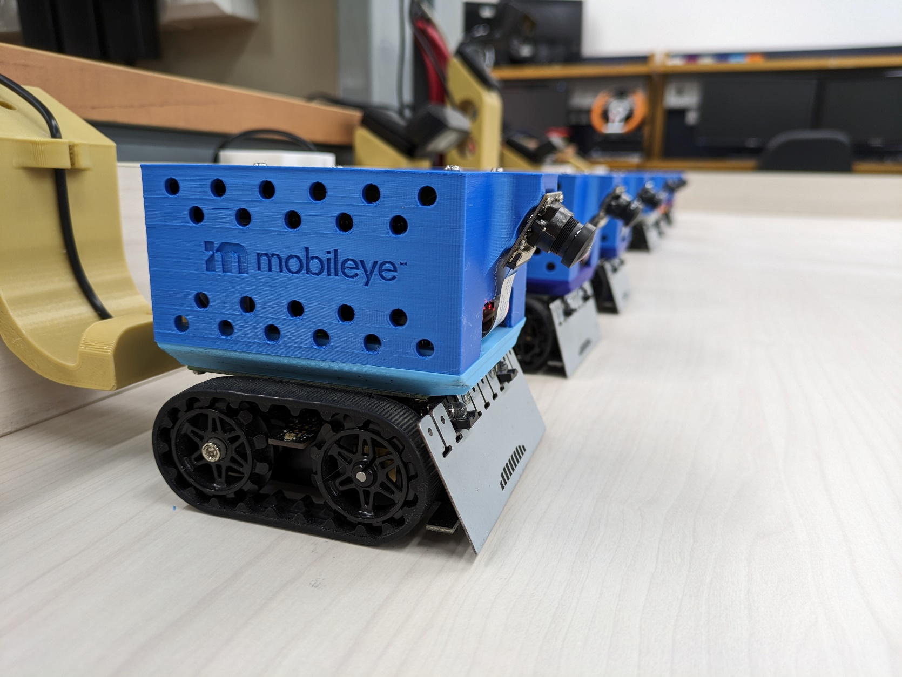
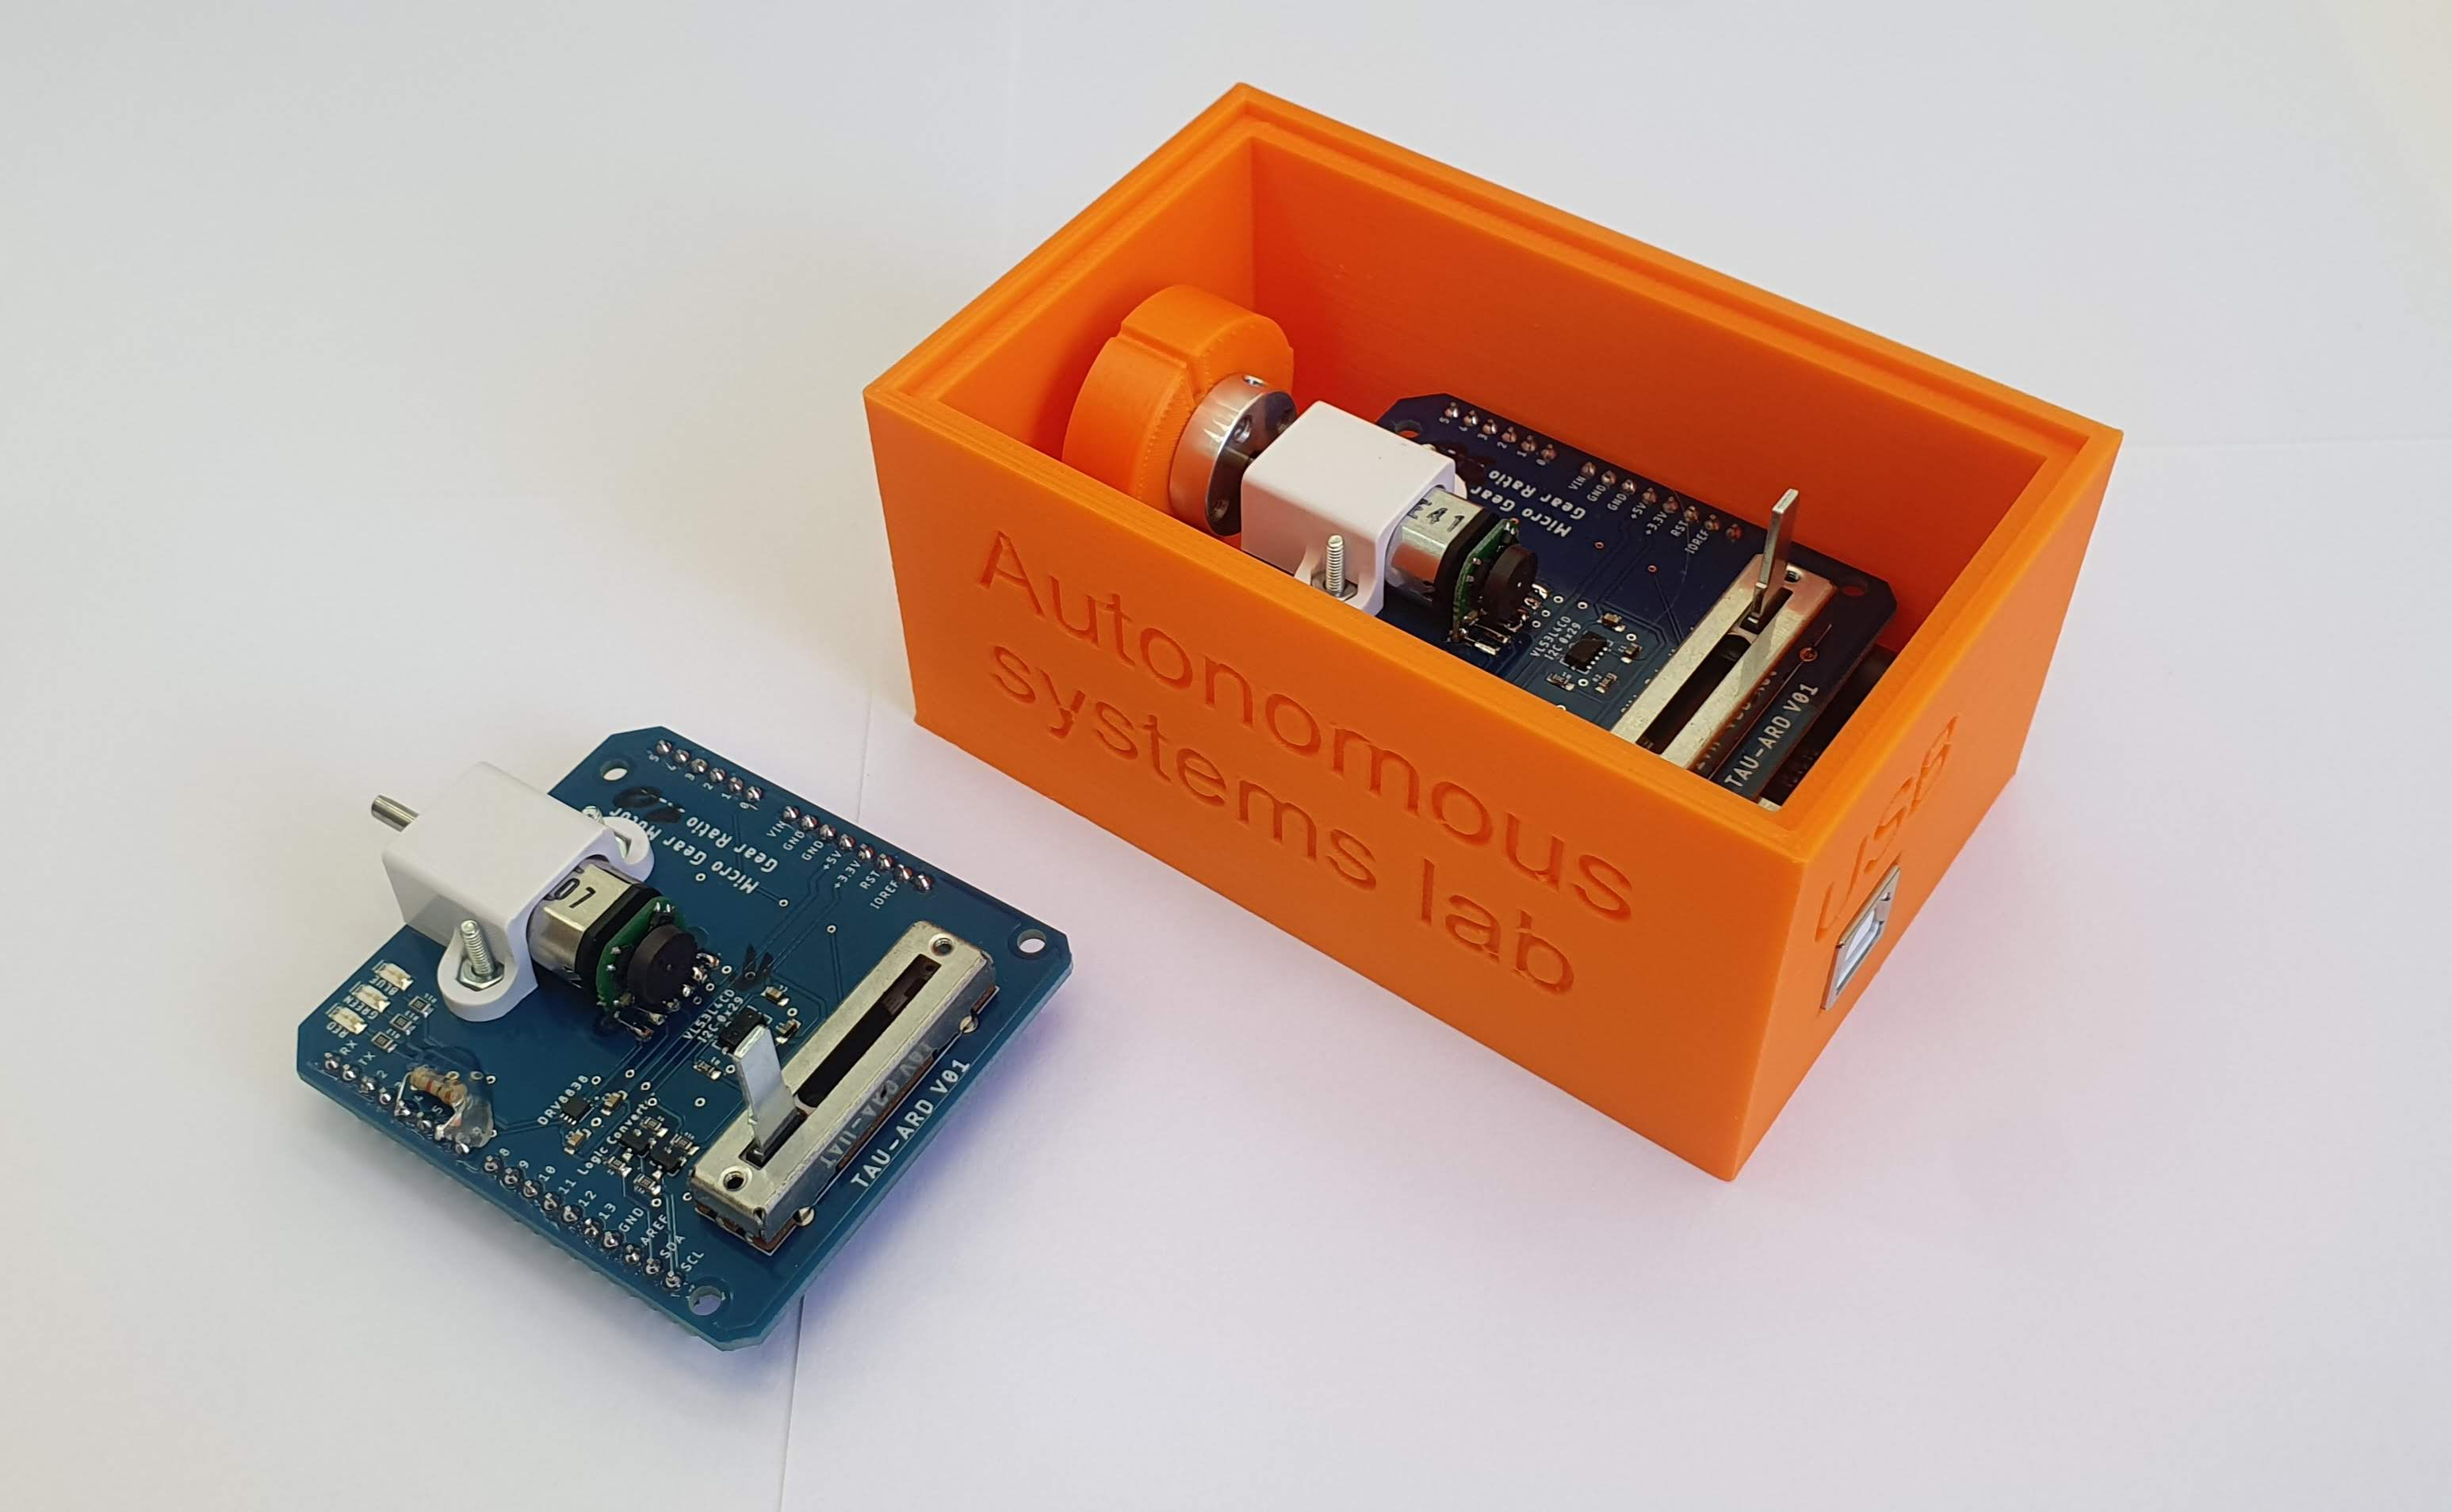
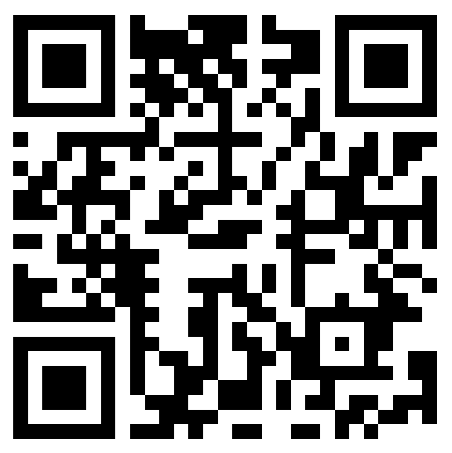
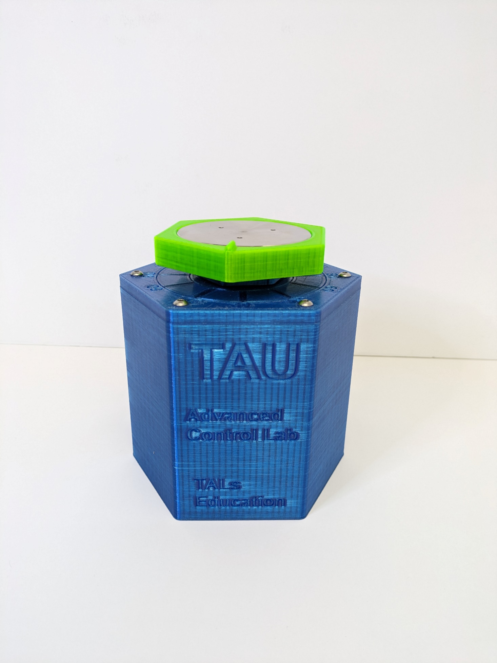
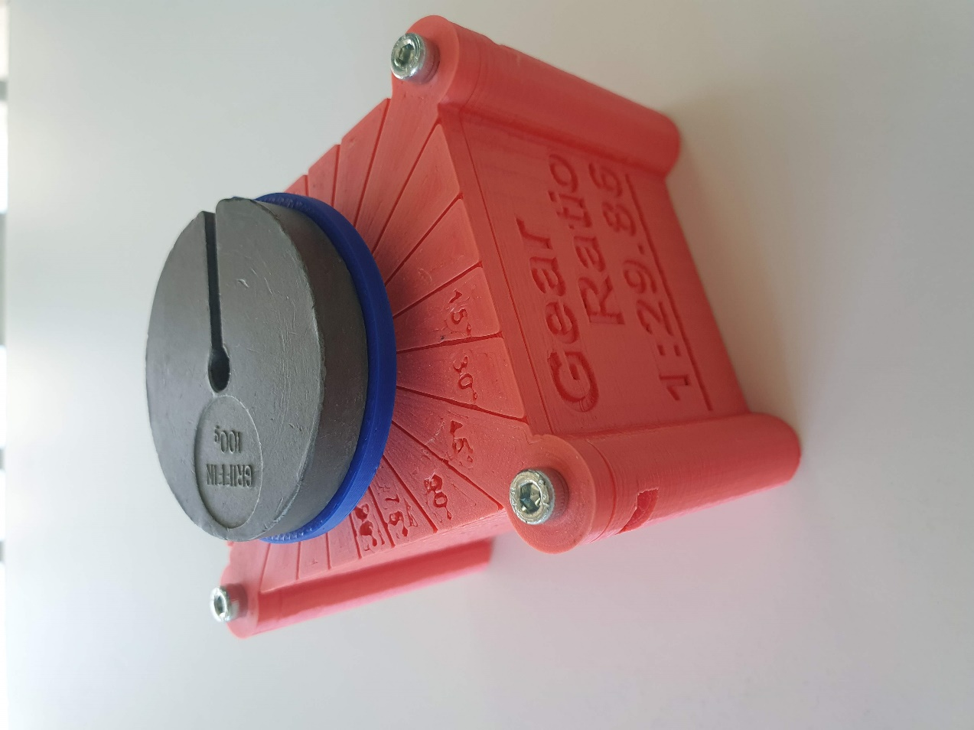
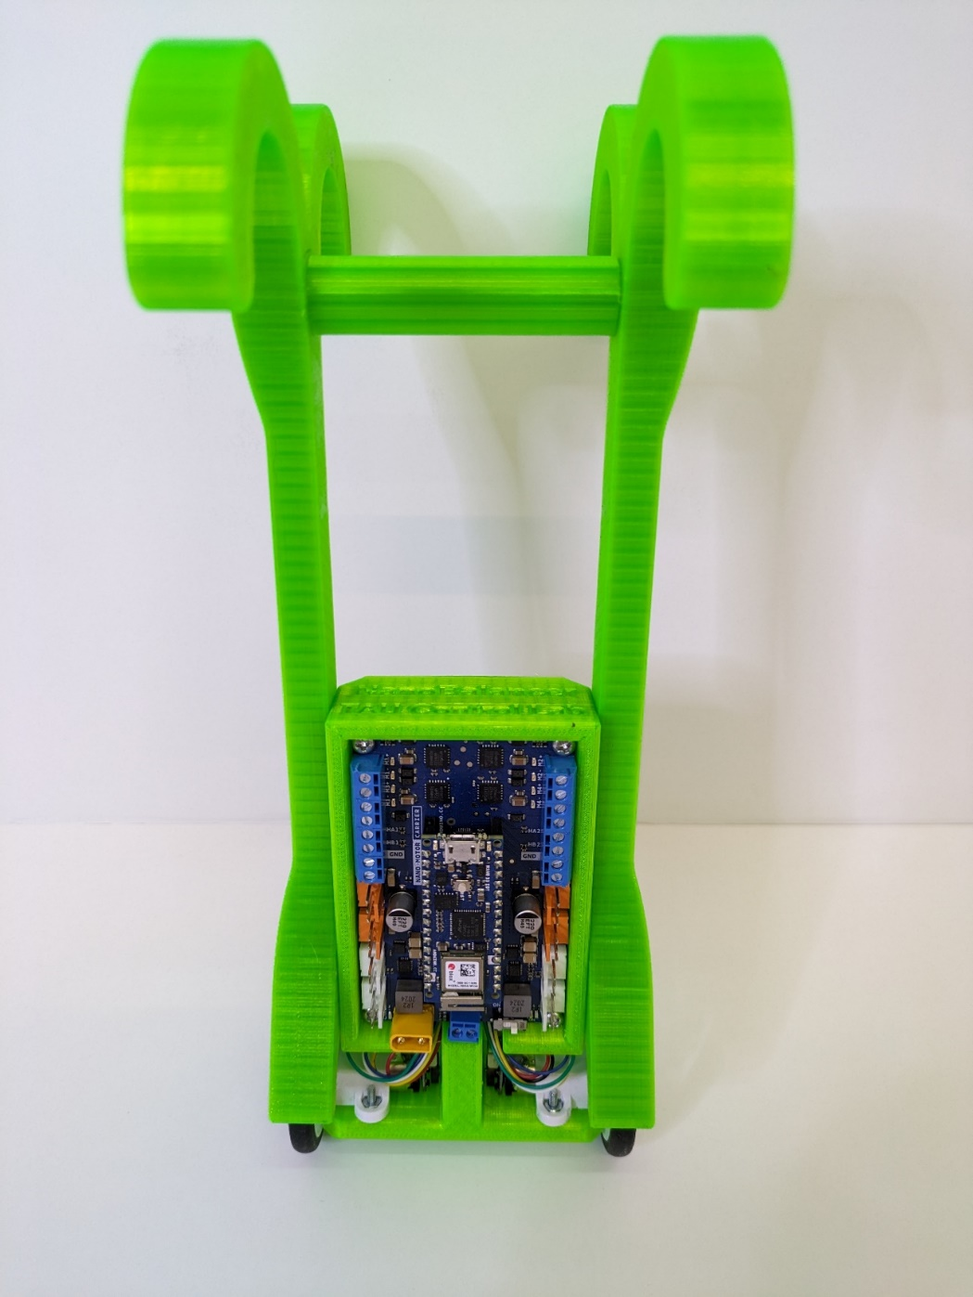
,
Our developed and manufactured open-source systems
Successful Hybrid Learning Experience
Want to learn more?

Slide 8
,
Simulink Environment as a Complementary Tool for Understanding Motor Control
Simulink as a powerful tool for simulation and design in motor control applications:
Electrical and mechanical simulations of an actual system
Continuous and discrete implementations of motor control
Motor control through encoder simulation
Real-time PID tuning
Easy to implement with clear and simple presentation of the system
Allows implementation of hardware in the loop

Slide 9
,
Covid period – Simulation & Remote experiments

Slide 10
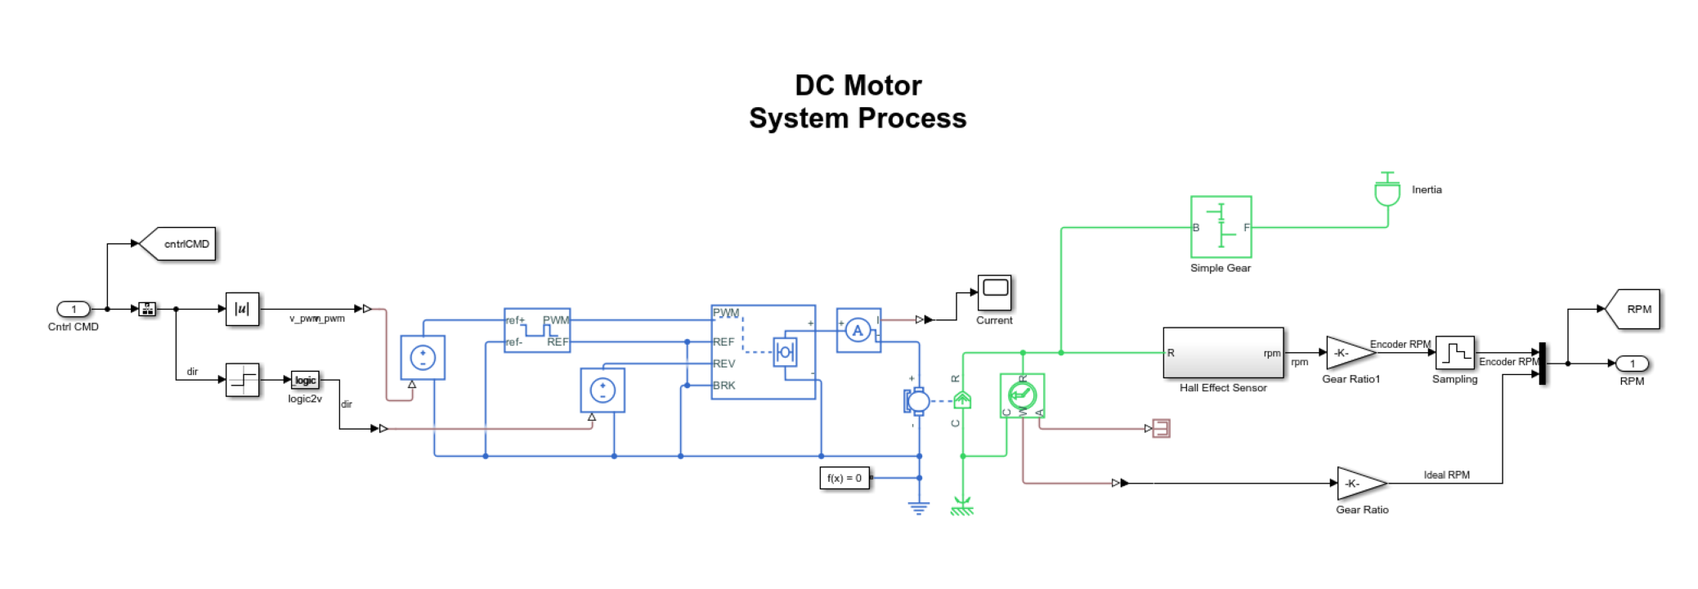
,
Simulation – Simscape & Discrete modeling

Slide 11
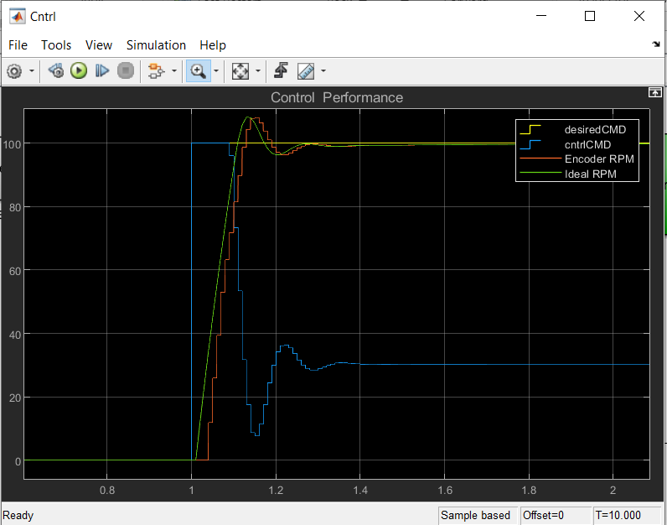
,
Simulation Results
Control design for linear system
Verification and comparison to a discrete system

Slide 12
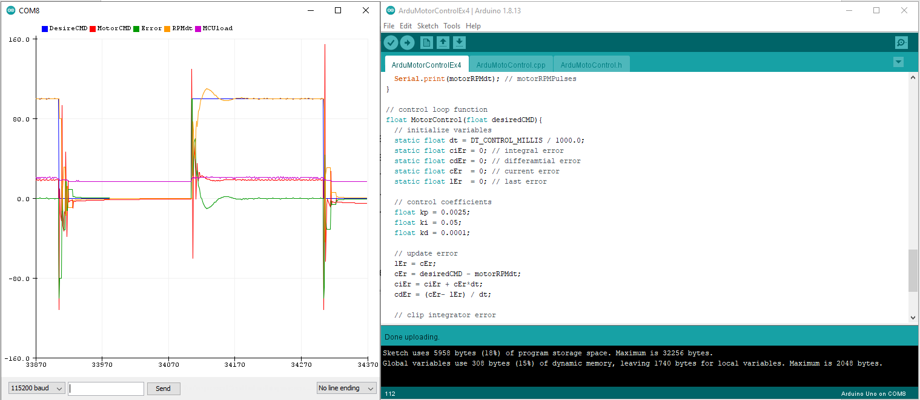
,
Hardware implementation – Arduino

Slide 13
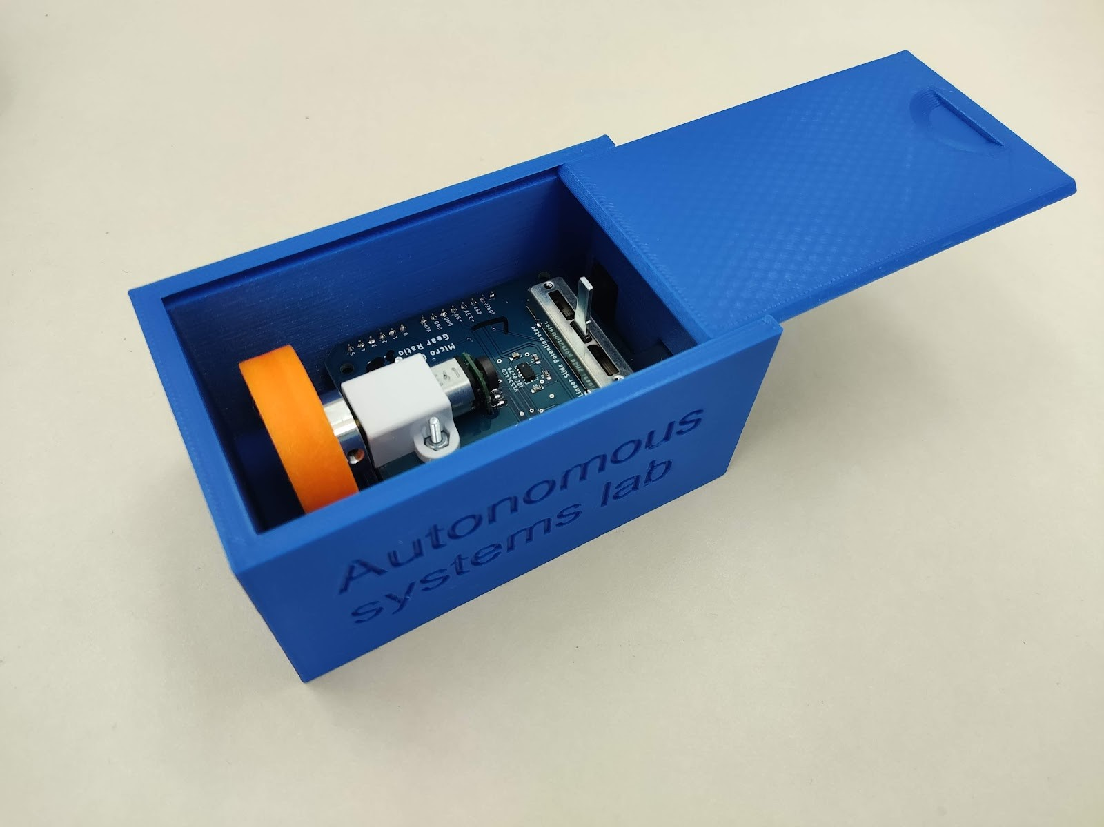
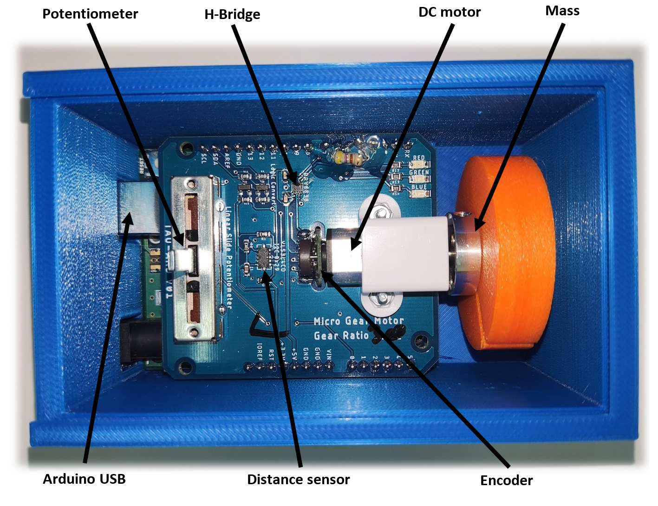
,
Improved Home Experiment (hands-on activity)

Slide 14
,
Hands-On Activity with Actual Hardware Examples (15m)
Participants’ opportunity to interact with the hardware components included in the home experiment kits.
A walkthrough of a basic experiment, illustrating how to set up the hardware and conduct tests.
Highlighting the process of applying theoretical knowledge to solve practical problems using the kits.

Slide 15
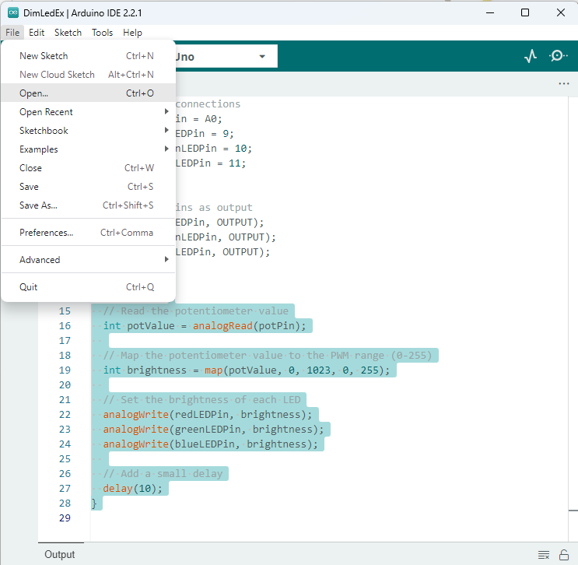
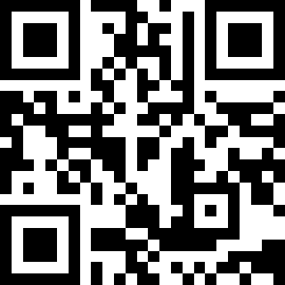
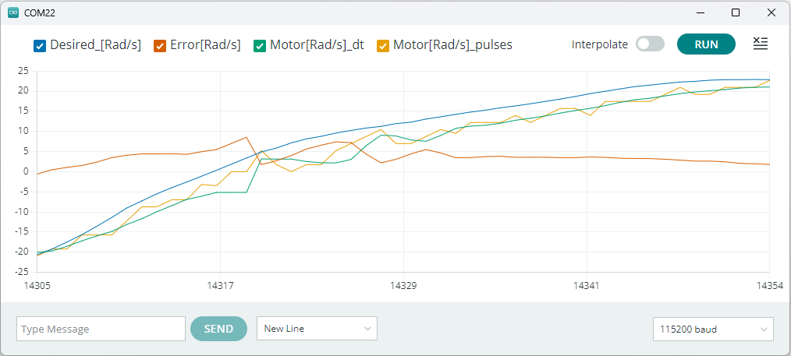
,
Hands-On Activity with Actual Hardware Examples (15m)
Setup Arduino IDE - https://www.arduino.cc/en/software
Examples: https://github.com/TALs-Education/SEFI-2024 or
tinyurl.com/SEFI24
Dim Leds using a potentiometer input
Velocity control of a DC motor
Optional – Time of Flight Sensor

Slide 16
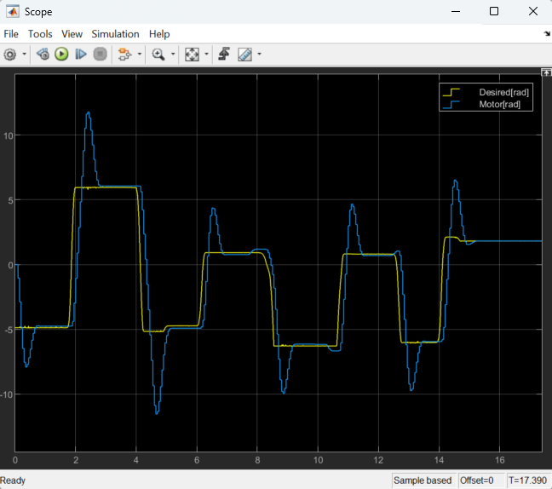
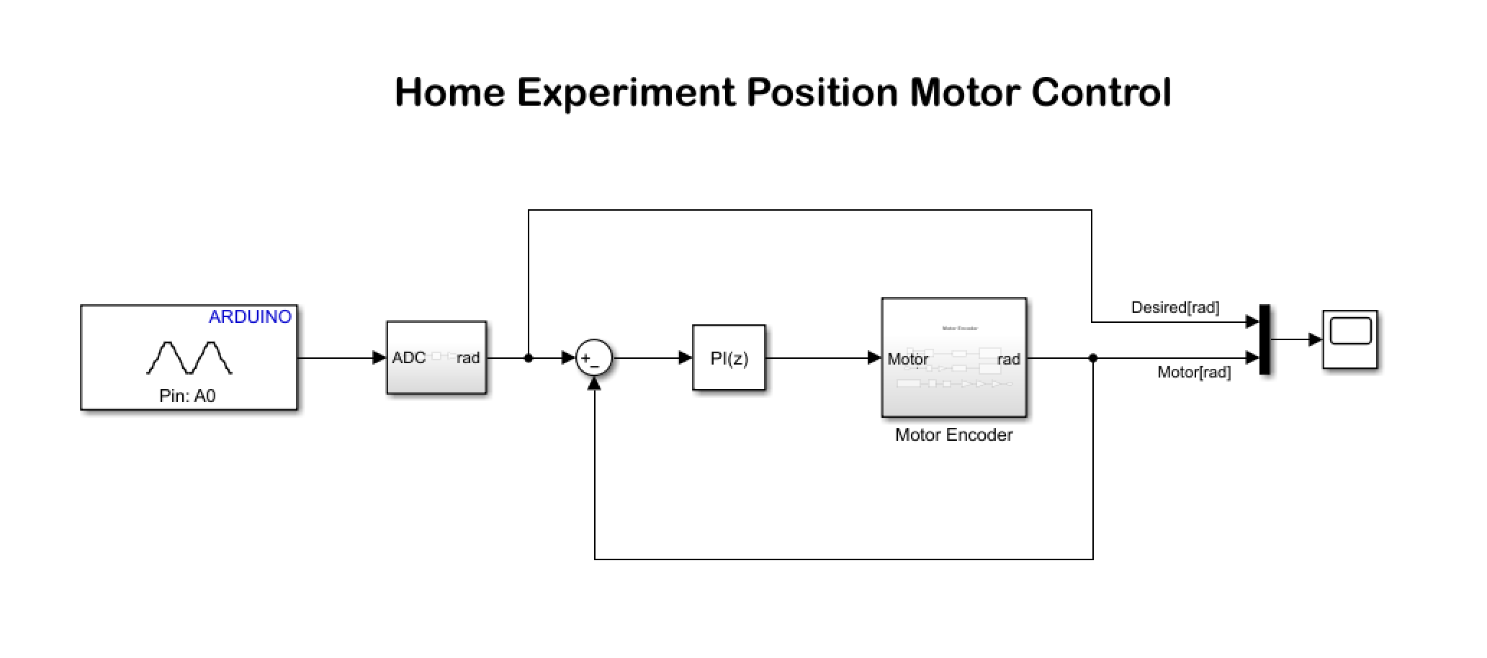
,
Hardware in the loop – Arduino Simulink

Slide 17
,
Small Group Discussion on the Benefits (15m)
Participants discussion in small groups: discuss your observations and the potential benefits of using home experiment kits in a hybrid learning model
A sharing session: participant discussion groups present their discussions and insights.

Slide 18
,
Conclusions (10m)
Summarize key points covered in the workshop, reiterating the value of hybrid learning and hands-on experience in engineering education.
Highlight how the skills and knowledge gained through the use of home experiment kits and Simulink can be applied in academic and industry settings.

Slide 19
,
Activities in our lab
Autonomous Systems Lab
Car Competition
Control Lab HexaMotor

Slide 20
,
Demonstrations
Want to learn more?
Arkadira@tauex.tau.ac.il

